Slide 1
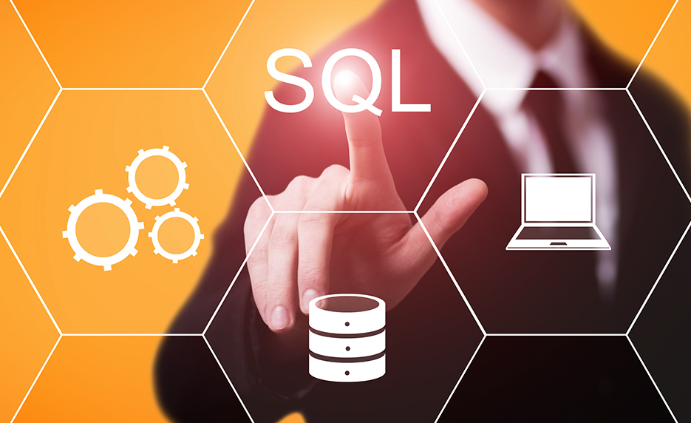
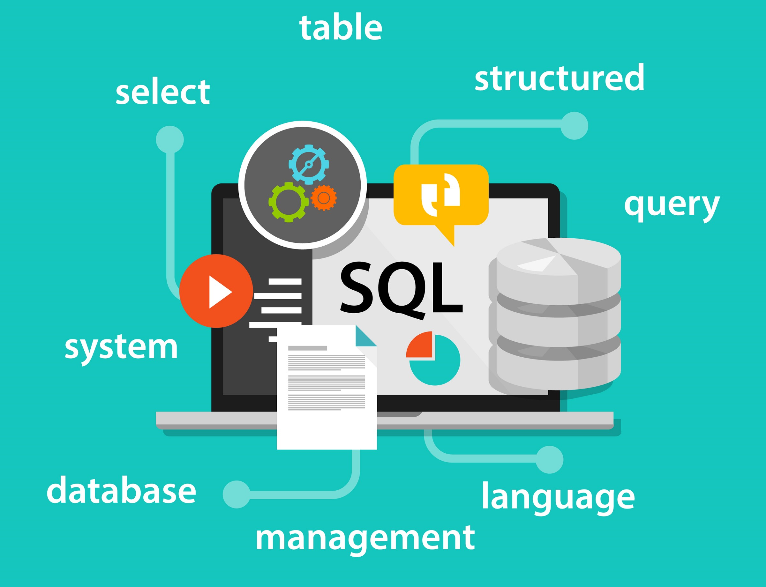
SQL Workbook by Maz

Slide 2
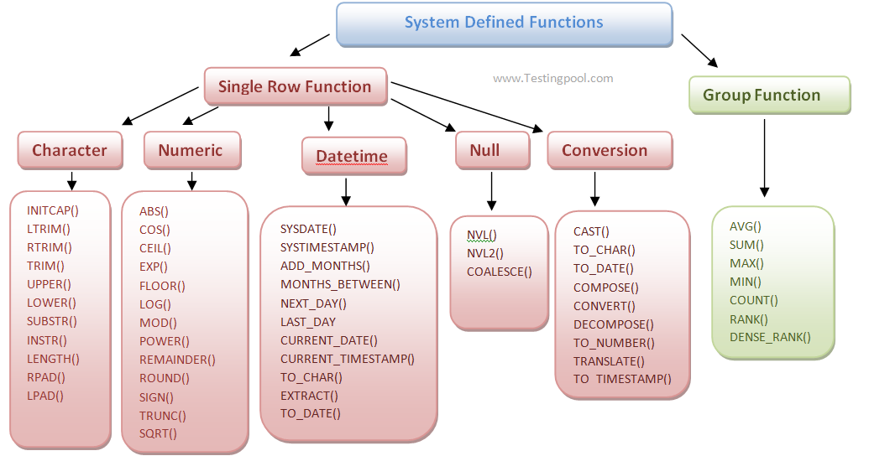
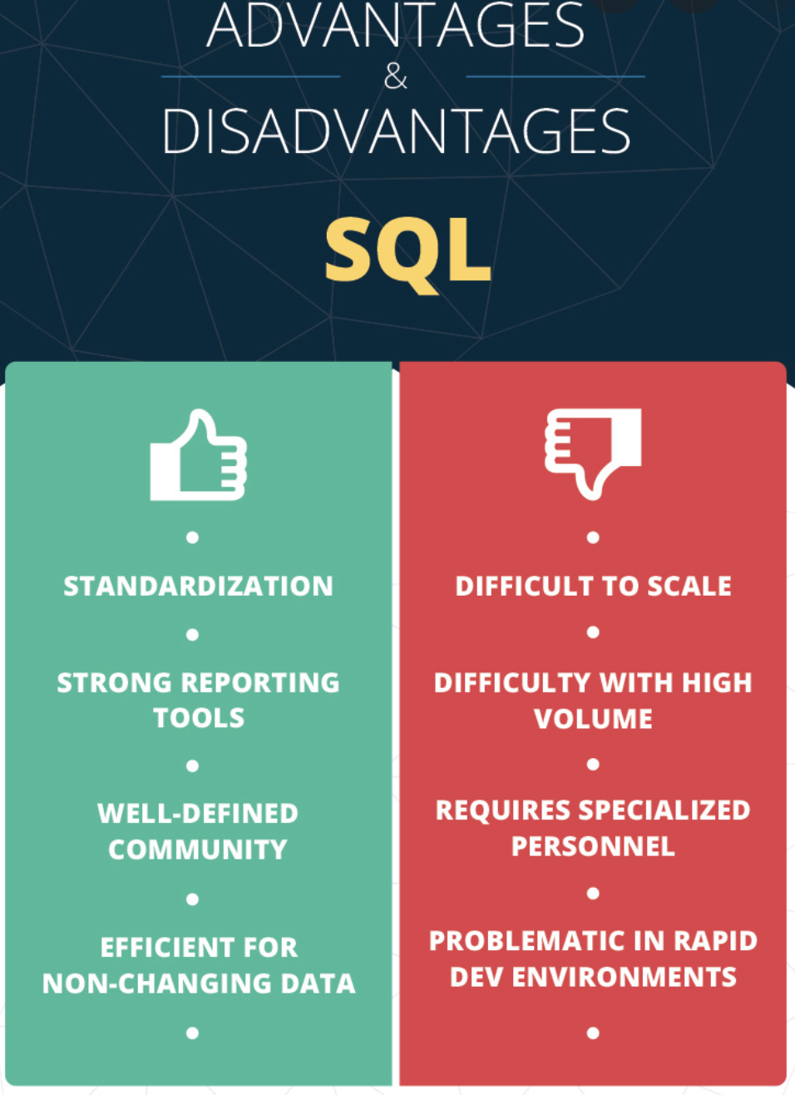
SQL
Cost | SQL Developer open source so is a free and SQL Developer is also included with any Oracle Database license, however is this cant be deployed in a commercial enterprise where a purchase and varies on the various vendors and packages.
Speed | SQL is much faster than Excel were some actions take mere minutes in SQL compared to nearly an hour in Excel, with performance is stable at 750 to 1300 microseconds
Analysis & ETL function | SQL (Structured Query Language) functions are sub-programs used in SQL database applications for processing or manipulating data and in 1986 to get first standardized by the American National Standards Institute (ANSI). SQL is a powerful tool as can create and manage large databases on many platforms, such as servers, computers, or tablets It is a non-procedural language (where the user has to suggest only “what to do” and not “how to do”) It helps communicate with databases in an easy-to-use English statement of a DML (data manipulation language) and DDL (data definition language) tools to support the creation and maintenance of databases it can retrieve data from a relational database or manipulate data by adding ( INSERT ), changing ( UPDATE ) and removing ( DELETE ). In the first phase of ETL process with extraction in the involving metric sources, database management systems and even simple spreadsheets for storage means , its commands can also facilitate fetching the data from various tables and even separate databases.
Alternatives | Teradata Vantage, MySQL, Oracle Database, IBM Db2, Amazon Relational Database Service (RDS), PostgreSQL, SAP HANA Cloud, Toad For Oracle.
Everyday use cases | From company employee databases to inventory management in supermarkets information is derived by end-users from companies such as Instagram, Amazon, Netflix, LinkedIn, Flipkart, and Instagram, along with the likes of Uber utilising it for data and performance analysis.

Slide 3
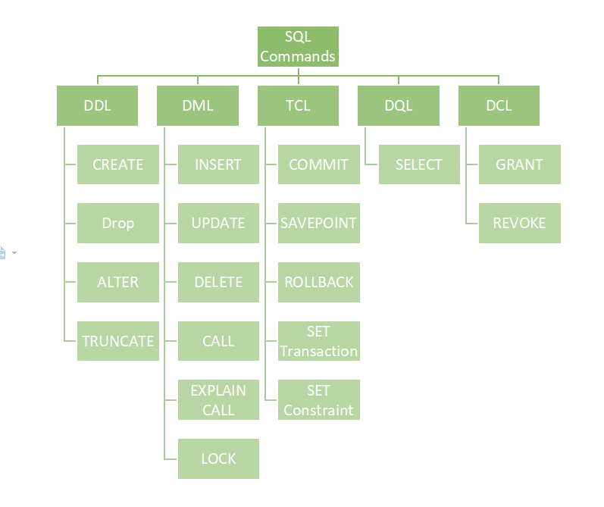
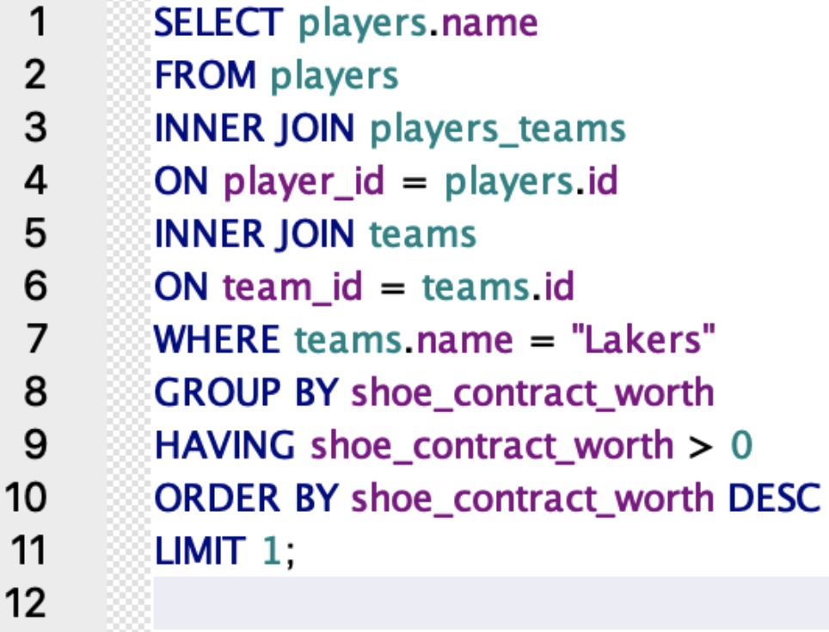
Functions
Its functions work like built-in programs utilised by relational databases that have:
Data definition language (DDL)
Data query language (DQL)
Data manipulation language (DML) functions
Data Control Language (DCL)
Transaction Control Language (TCL)
Along with even more types of functions.

Slide 4
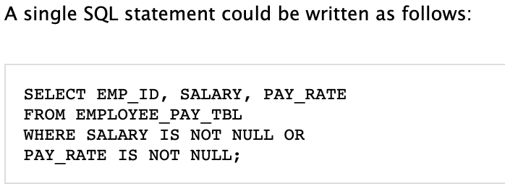
Single queries
The single query is one SELECT statement, where you get everything in one go.

Slide 5
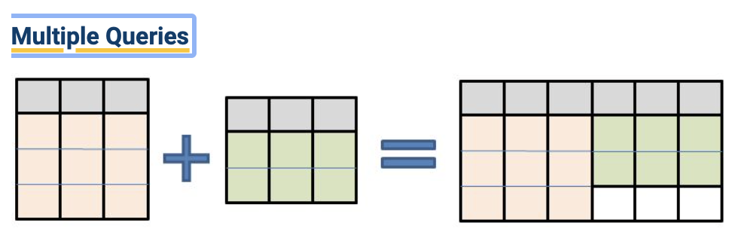
Multiple queries
Multiple queries or compound queries are by using more queries from more than one table by the UNION operator into a single result.

Slide 6
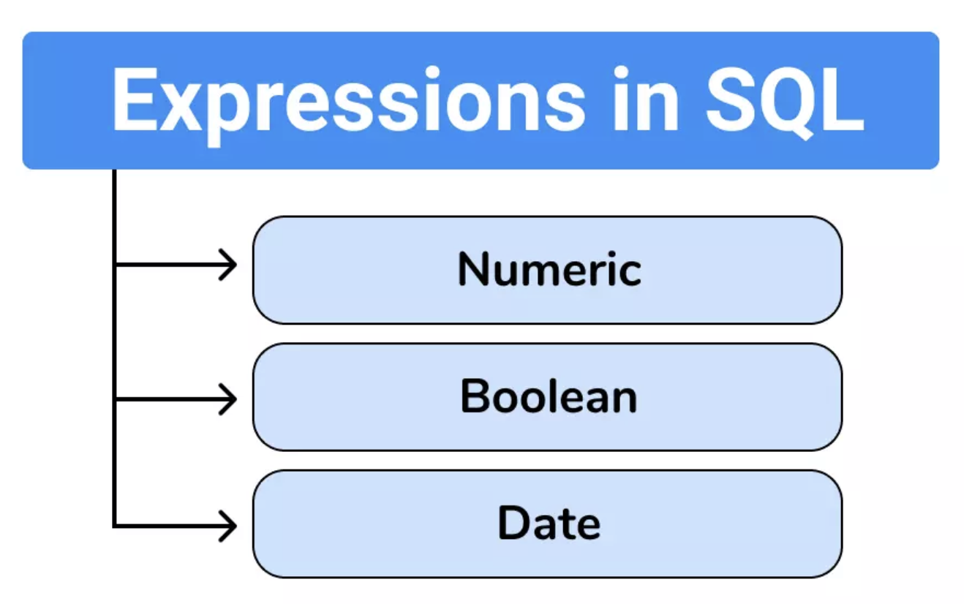
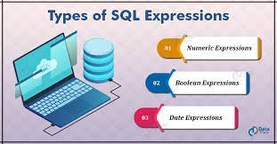
Expressions
There are 3 types of expressions in SQL, which are
boolean expressions
numerical expressions
date time-related expressions.

Slide 7
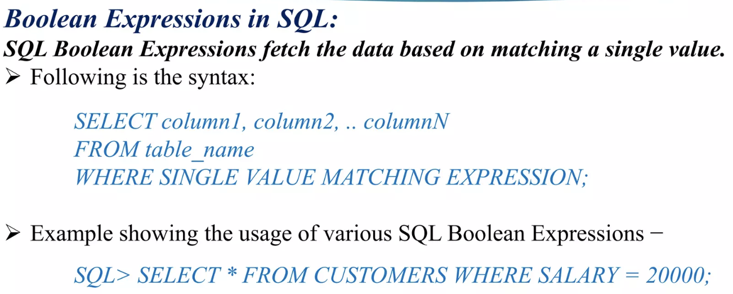
Boolean Expressions
The Boolean Data Type originates from George Boole, who was a mathematician that wrote wrote “An investigation into the Laws of Thought”. This was a system of logic which is used as the basis for the majority of computer programming languages, to describe the true values such as 1 and false values such as 0. This was used commercially by United States Air Force with their massive computer called AN/FSQ-7.
Boolean expressions return one of the three boolean datatype results that are:
·TRUE
·FALSE
·UNKNOWN
Boolean value operators examples include:
>= – True if a number is greater than or equal to another.
<= – True if a number is less than or equal to another.
== – True if two values are equivalent.
!= – True if two values are not equivalent.
&& – True if both values are true.
|| – True if either of the values are true.
! – True if the value is false.
~ – Reverses all of the bits in a variable (e.g.: 0000000000000000 becomes 1111111111111111).
These are mainly used by WHERE clauses filtering data or comparison operators such as ‘AND’ along with ‘OR’. Conditional tests may include; email validation to correct new password format.

Slide 8
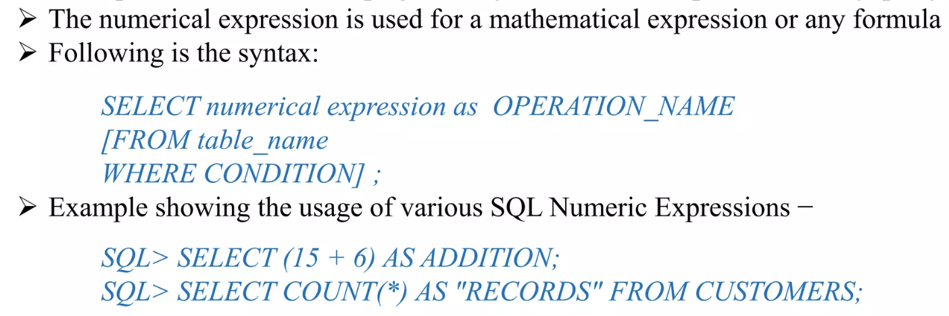
Numerical Expressions
Numerical expressions that result in numeric values with one of the following types
BIGINT – are used when integer values might exceed the supported range
DECIMAL – to return a decimal value
DOUBLE PRECISION - has a range of around 1E-307 to 1E+308 with a precision of at least 15 digits.
INTEGER - written without a fractional or decimal component
REAL - is an approximate number with floating point numeric data
SMALLINT - stores small whole numbers that range from –32,767 to 32,767

Slide 9
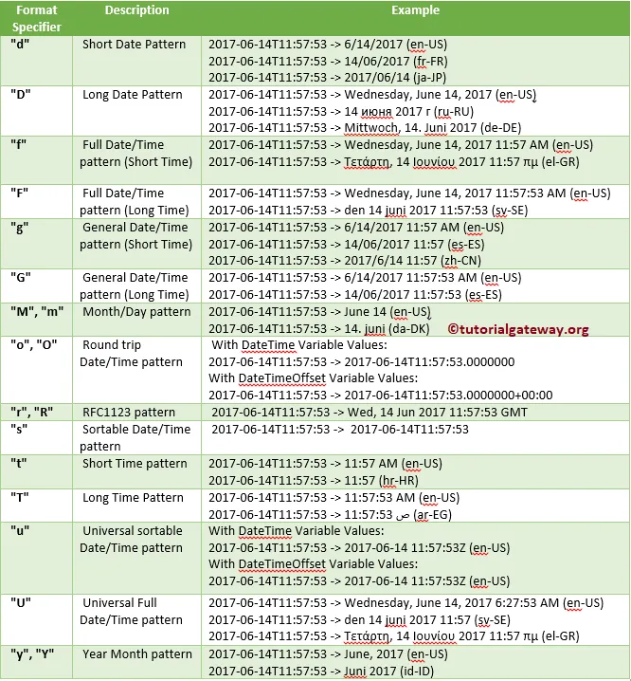
Date expression
Used for values that contain both date and time
Issues can arise with unidentical formats e.g; as if the date format doesn’t match the format of the date column in the database

Slide 10
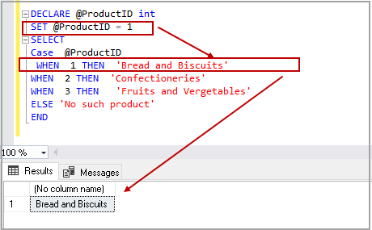
CASE expression
There are also CASE expressions which is a if-then-else statement, which is followed by either a WHEN or THEN statement, and then an optional ELSE statement, then finally ending with a END statement.

Slide 11
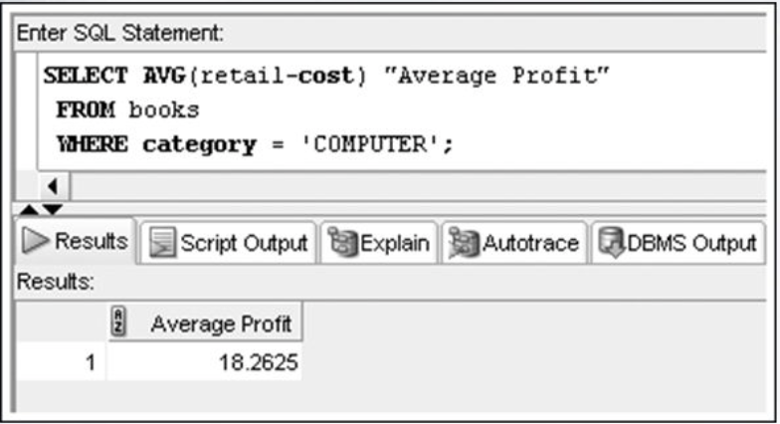
AVG
The AVG() function takes a column name , which is known as the operand) and then works out the average values of all the columns and where NULL values are ignored.

Slide 12
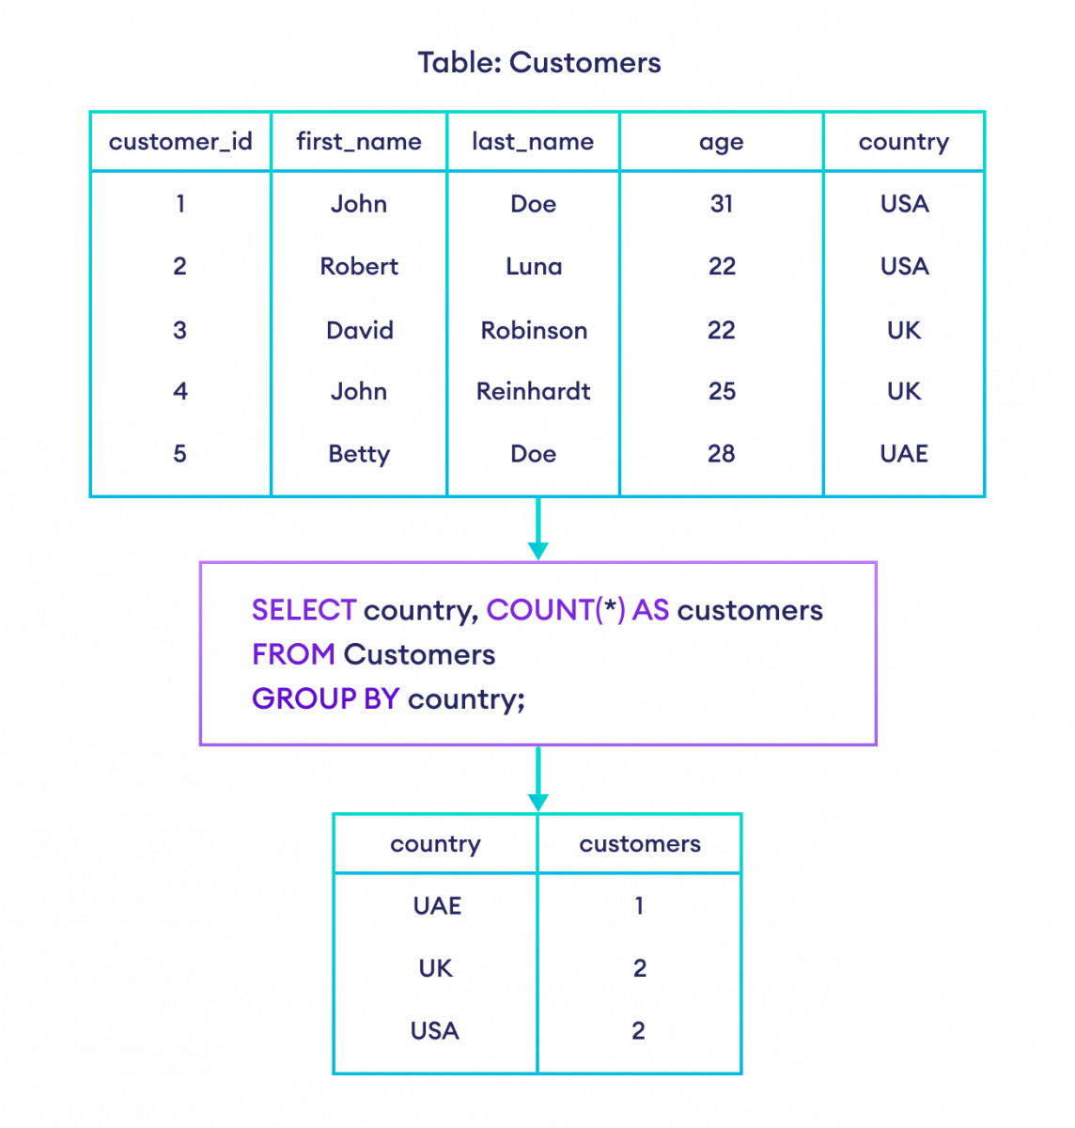
COUNT
The COUNT() function returns the number of rows that matches a specified criterion.
COUNT(*) will count all the rows in the table, including NULL values.
COUNT(column name) will count all the rows in the specified column while excluding NULL values
Other clauses which can be added include GROUP BY, HAVING, ORDER BY and WHERE.

Slide 13
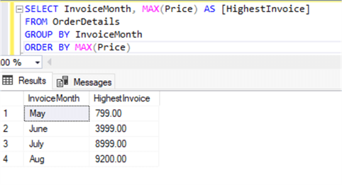
MAX
The MAX function is to return the maximum value of selected column, from an expression in a SELECT statement.

Slide 14
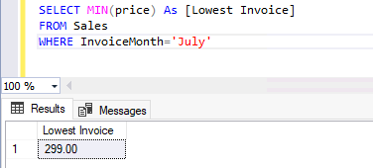
MIN
The MIN function is to return the maximum value of selected column, from an expression in a SELECT statement.

Slide 15
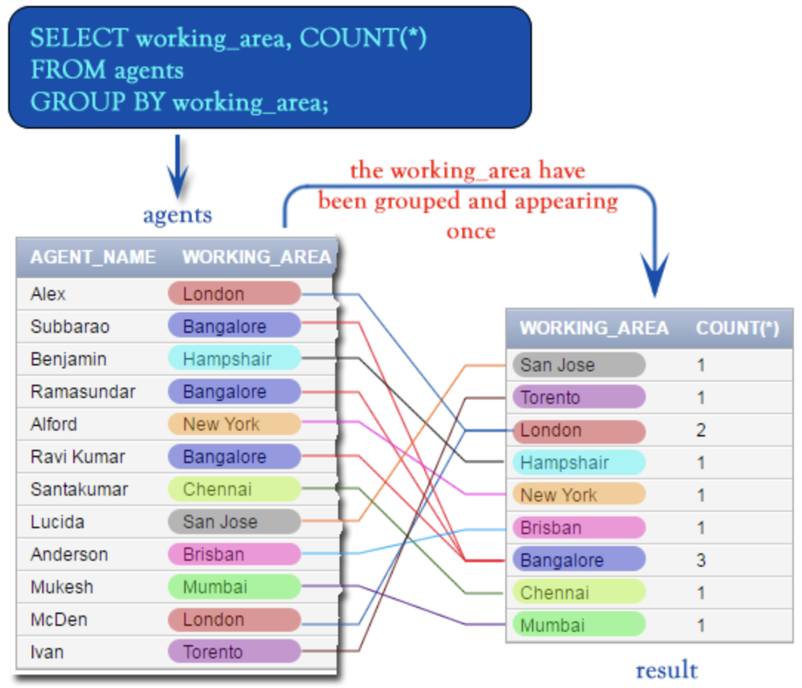
GROUP BY
Once aggregate function returns the summary (count, min, max, average, sum, etc.,) , then the GROUP BY statement arranges these rows into a group.

Slide 16
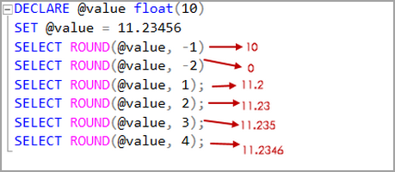
ROUND
The ROUND function is used for rounding off specific number to a specified amount of decimal places.

Slide 17
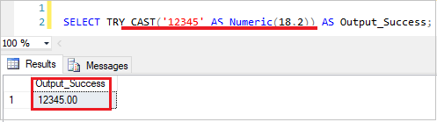
CAST
CAST converts data from one data type to another specified type.

Slide 18
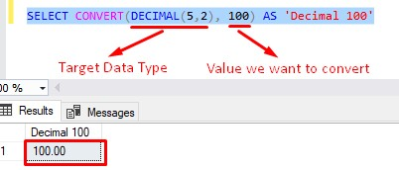
CONVERT
CONVERT converts the data from one data type to another simarly to CAST but is specific to SQL.

Slide 19
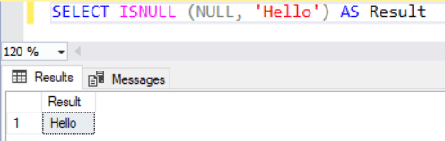
ISNULL
Returns a specified value if the expression is NULL

Slide 20
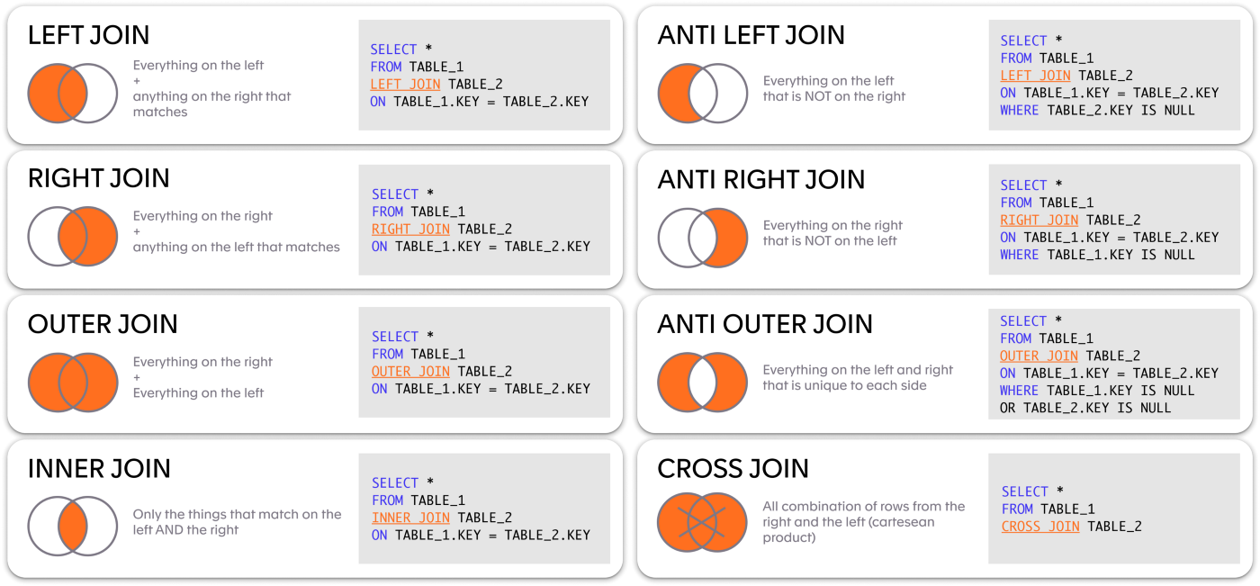
JOINS
A JOIN statement combines rows from two or more tables using a common related column shared by them.

Slide 21
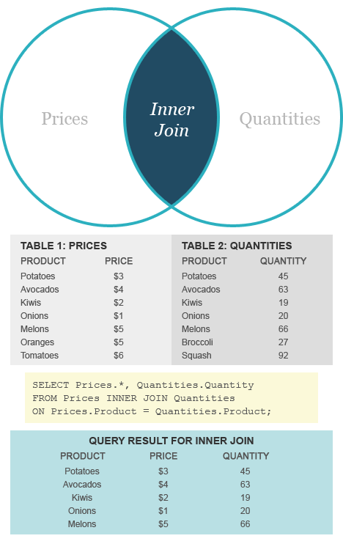
INNER JOIN
Returns records that have matching values in both tables. Use the INNER JOIN function to find duplicates that exist in multiple tables.

Slide 22
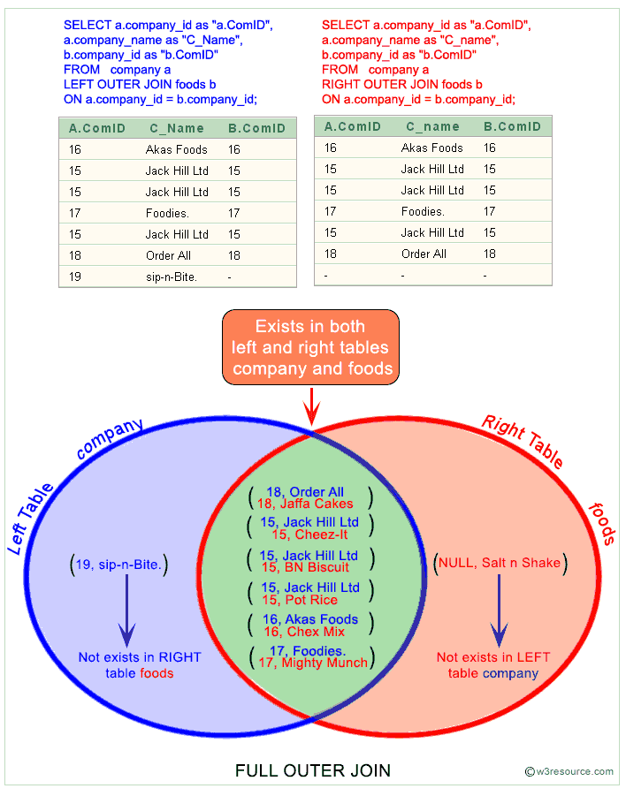
OUTER JOIN
Selects records that have matching values in both tables

Slide 23
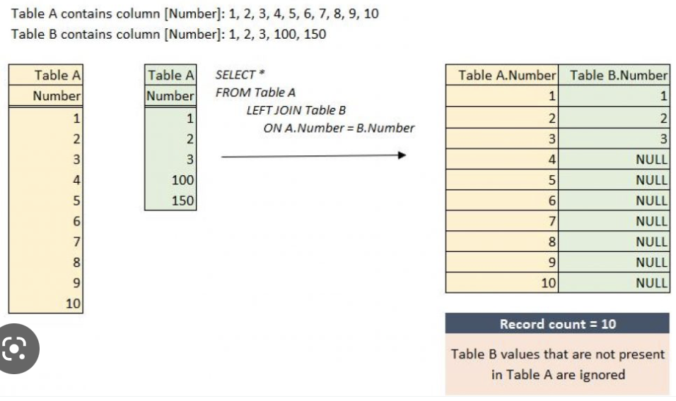
RIGHT AND LEFT JOIN
RIGHT JOIN shows records from the right table and matching records from the left table, then its vice-versa for LEFT JOIN.

Slide 24
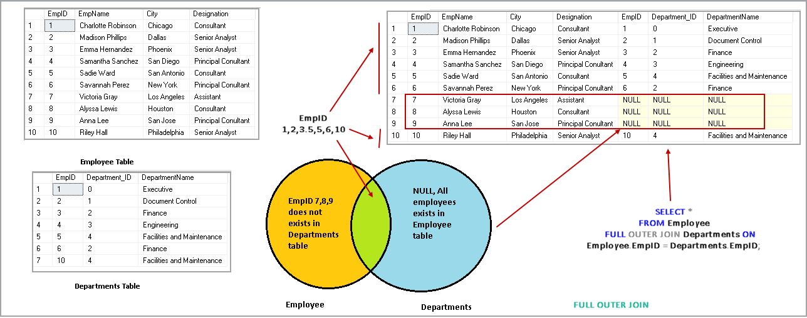
FULL JOIN
FULL OUTER JOIN or FULL JOIN are identical , which return all records on both sides.

Slide 25
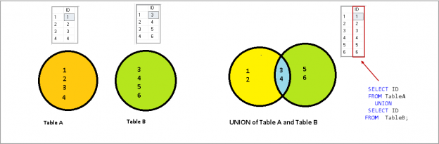
UNION
Combines results of two SELECT statement queries

Slide 26
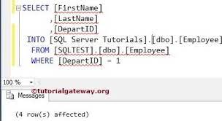
SELECT INTO
Copies from table onto another

Slide 27
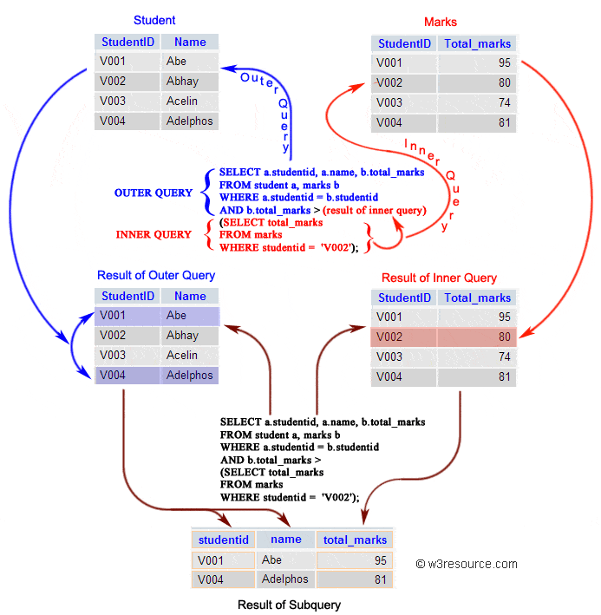
SUBQUERIES
Subqueries/nested quries/inner queries, where a SELECT statement is embedded/nested within another SELECT statement query.

Slide 28
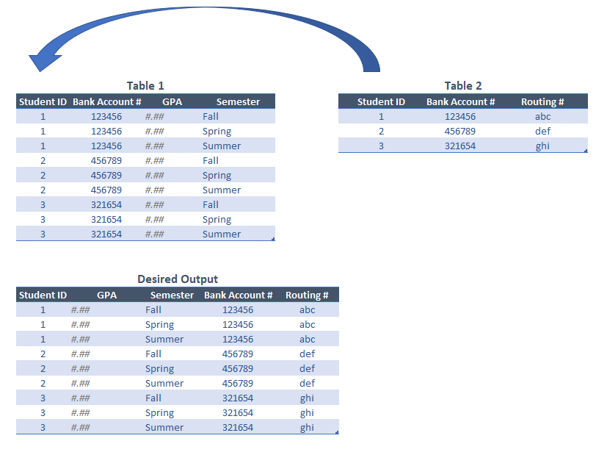
JOINS WITH DUPLICATE VALUES
This could be for various reasons such as a customer visting several branches and also can result from using an incomplete ON condition but can be avoided by using SELECT DISTINCT or use of COUNT and GROUP BY.

Slide 29
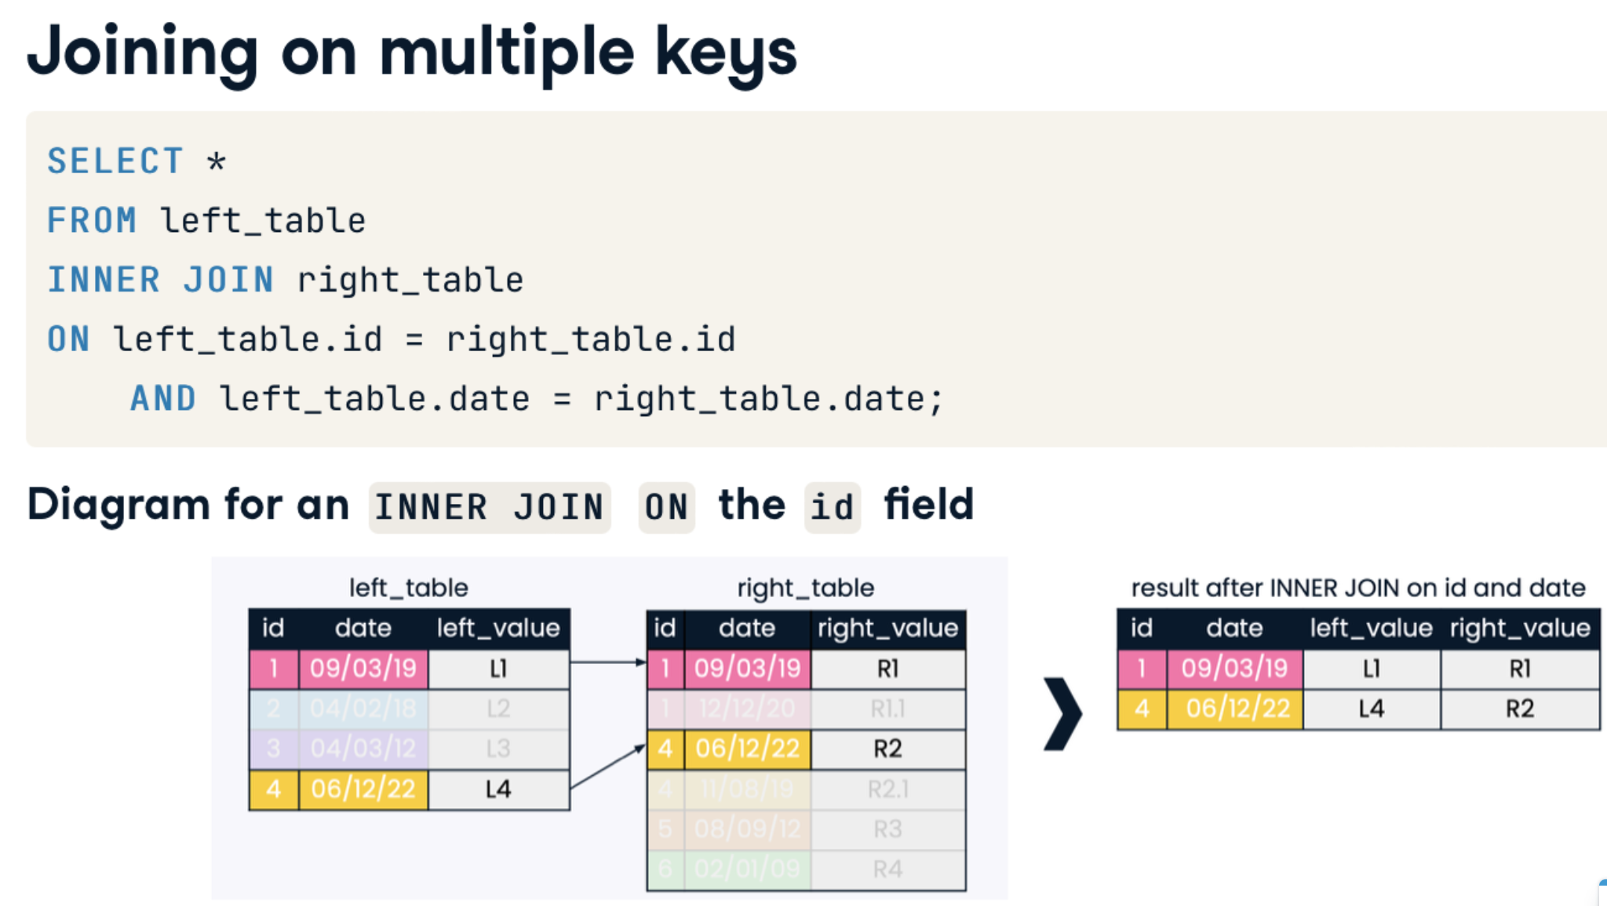
JOINING ON MULTIPLE FIELDS
Joining on multiple fields works the same as joining on a single field.

Slide 30
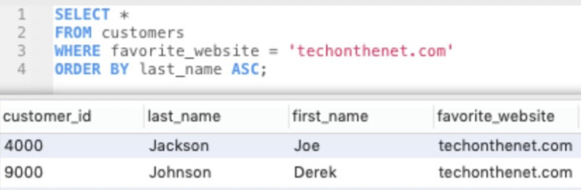
SELECT AND SELECT * STATEMENTS
Similar to the select all option in other programs, where the SELECT column returns only the value of that column, whilst SELECT * returns the value of every column in the table.

Slide 31
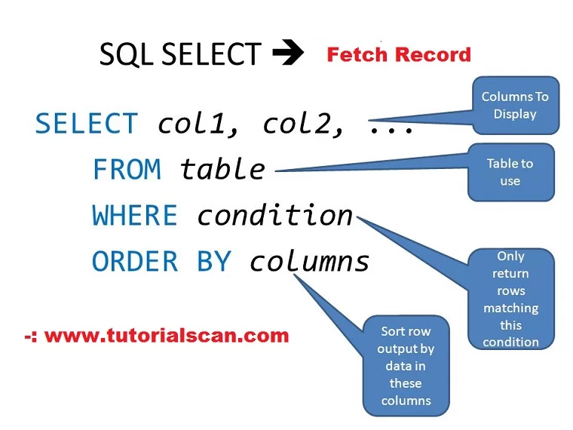
FROM
The FROM clause specifies the table(s) in which these data columns are located.

Slide 32
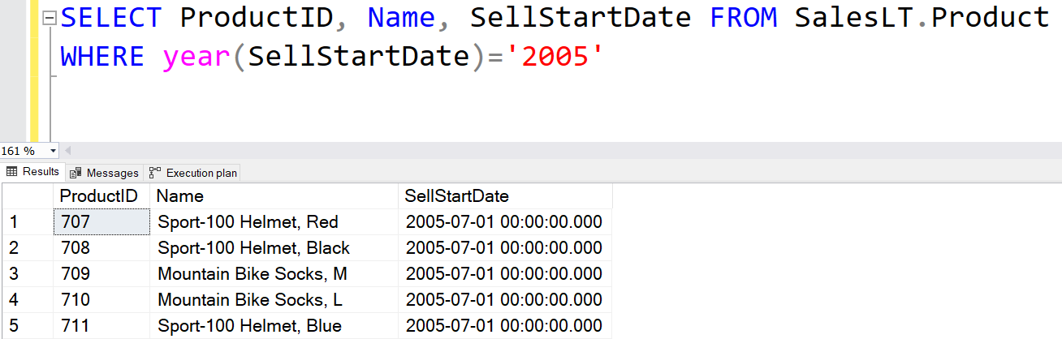
WHERE
Keyword used to specify the exact criteria of data or rows that will be affected by the specified SQL statement

Slide 33
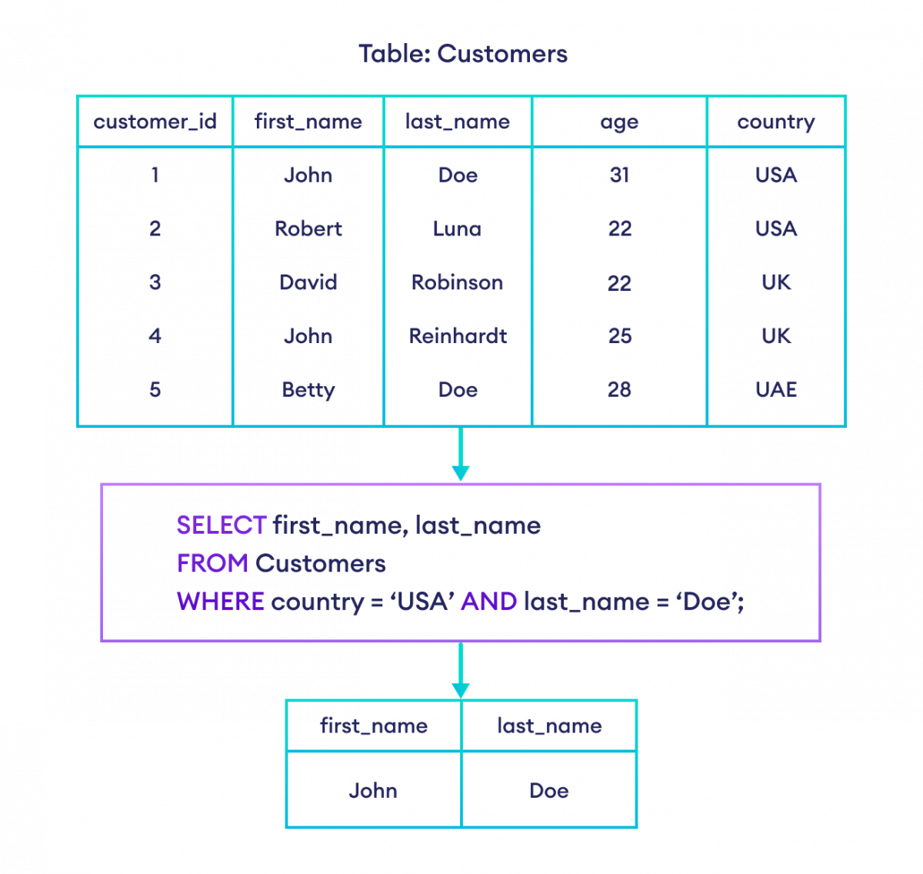
AND
Allows the existence of multiple conditions in an SQL statement for filtering data more precisely based on conditions.

Slide 34
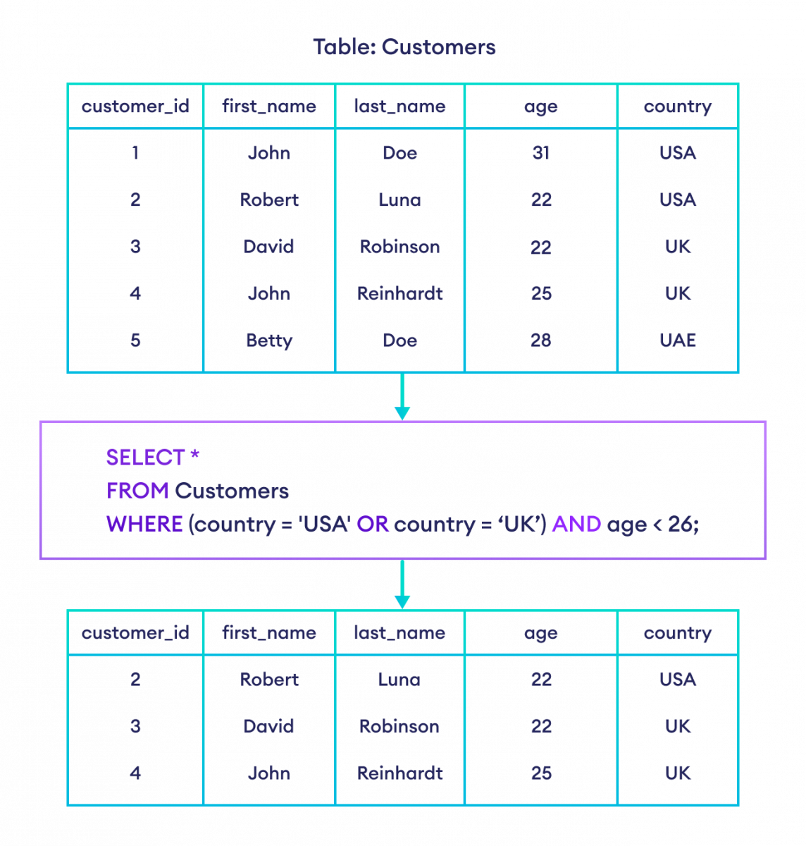
OR
Used to combine two conditions, OR operators are evaluated after AND operators.

Slide 35
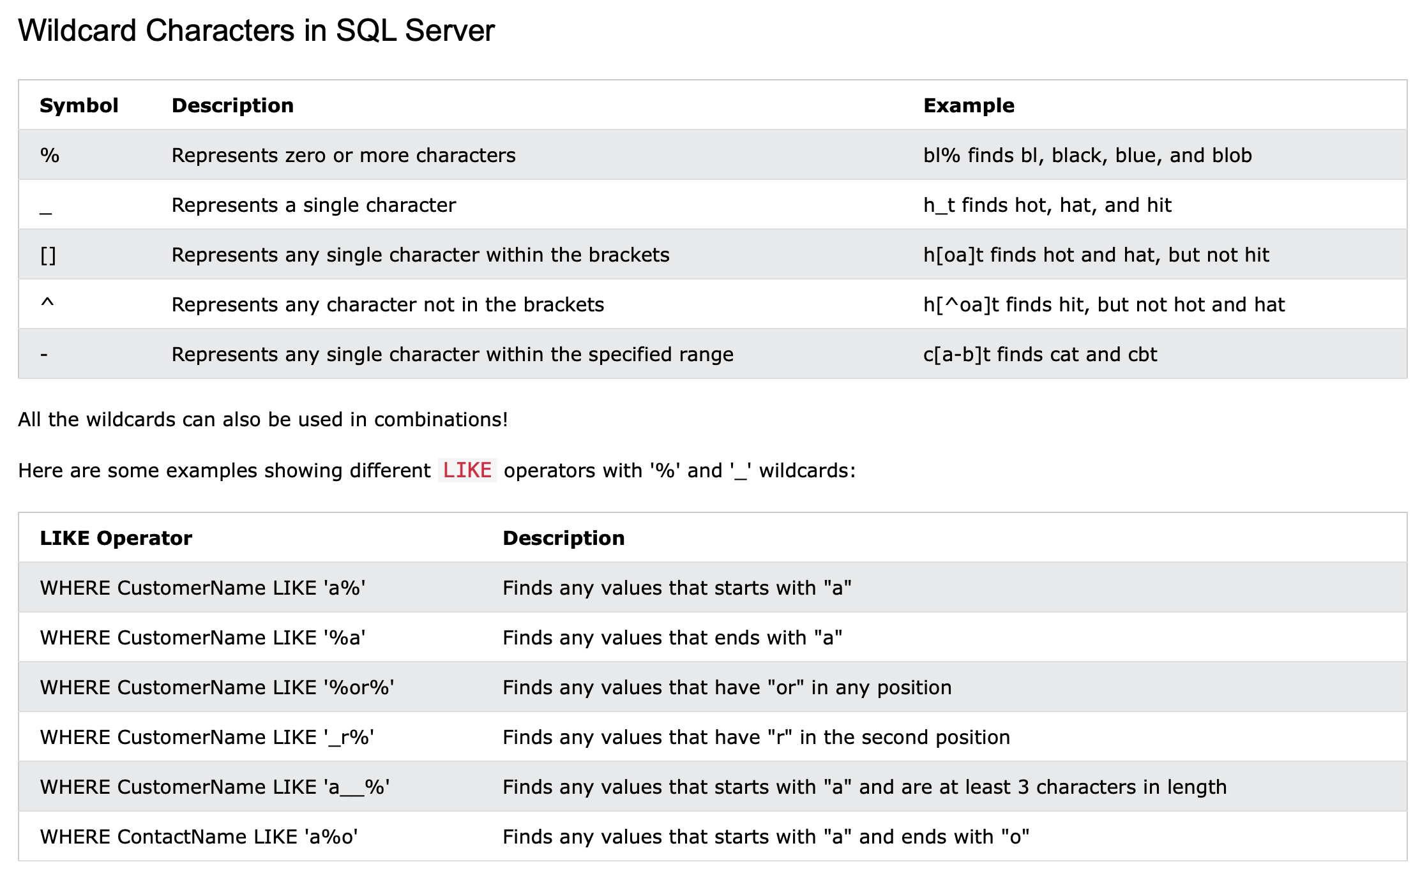
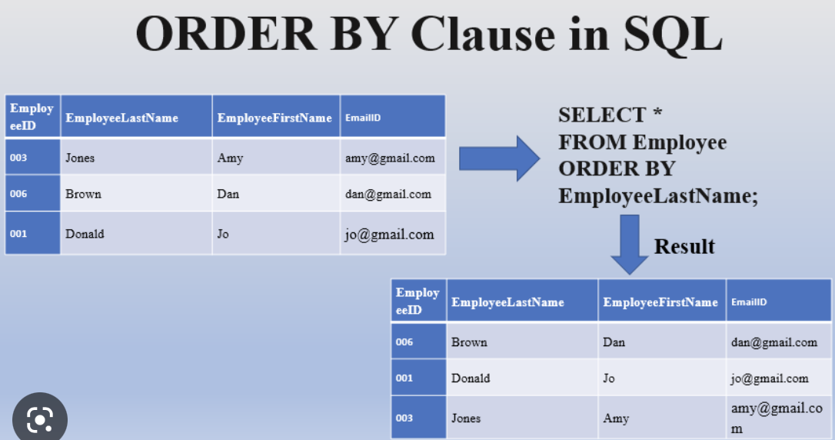
USE OF WILDCARDS AND ORDERING
A Wildcard in SQL is used to represent any one or more characters inside brackets.
Ordering is putting in columns in a specific order.

Slide 36
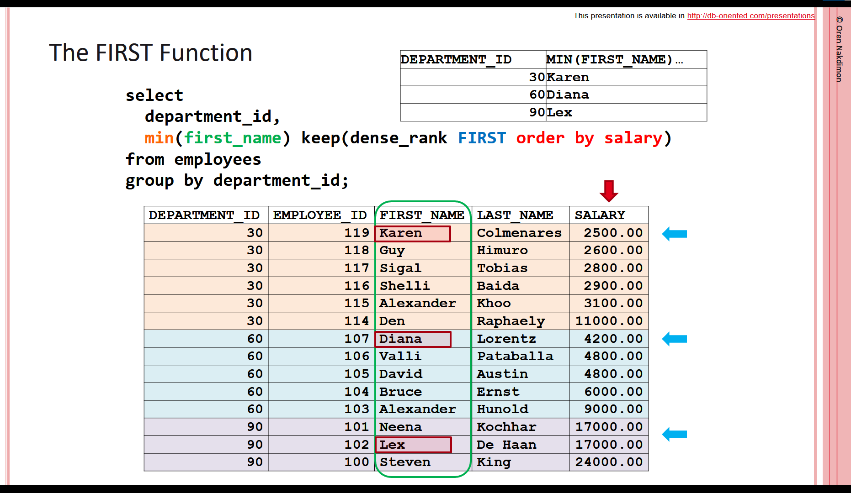
SELECTING FIRST & LAST OCCURRENCES
FIRST() to extract the first entry of a particular column and LAST() to extract the last entry of a particular column in a table

Slide 37
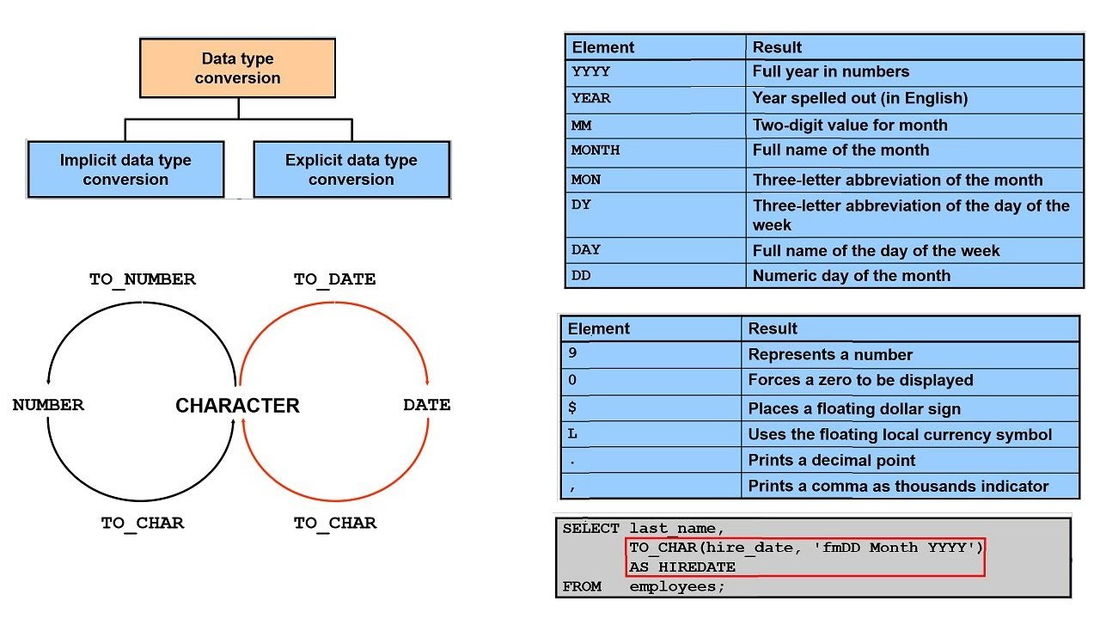
IMPLICIT DATA CONVERSION
Implicit conversions are not visible to the user but its when SQL automatically converts the data from one data type to another.

Slide 38
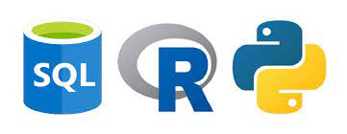
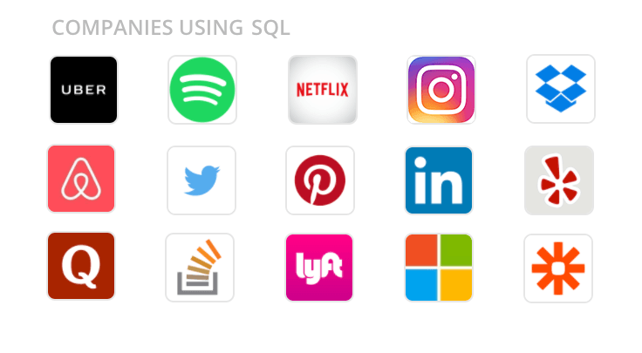
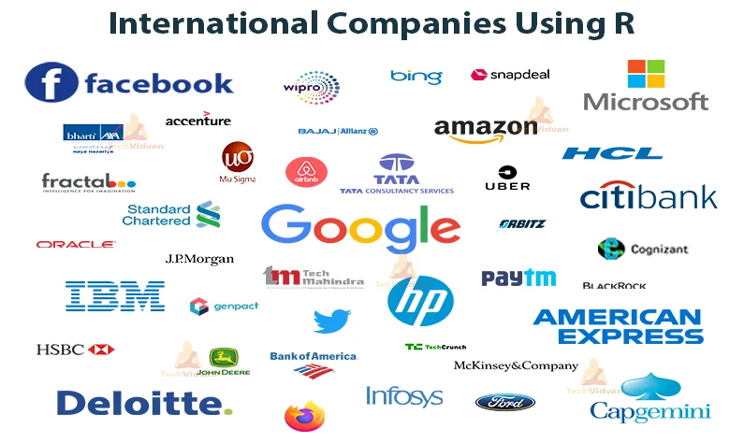
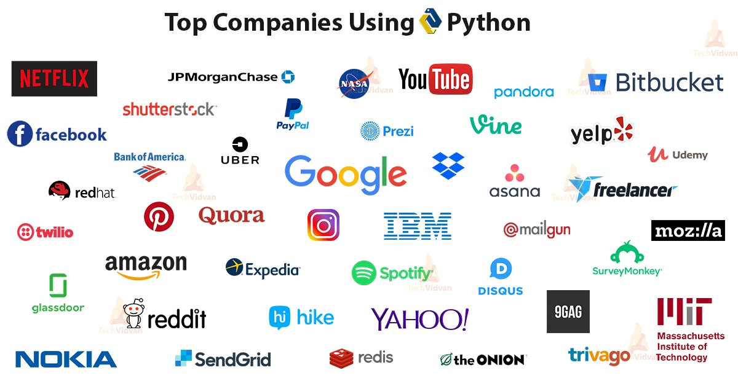
SQL, Python and R
Data analysts use all-purpose such as SQL (Structured Query Language) to communicate with relational databases, but when it comes to cleaning, manipulating, analyzing, and visualizing data, then you would use a general purpose programming language like Python or a language for statistical computing such as R, however SQL is still more efficient. All are available for free as open source and are relational databases.

Slide 39
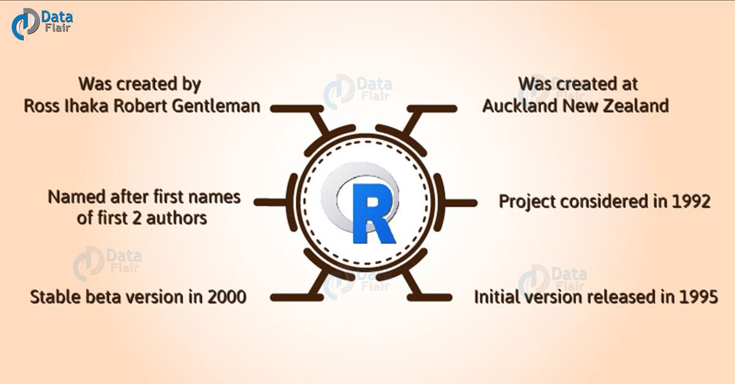
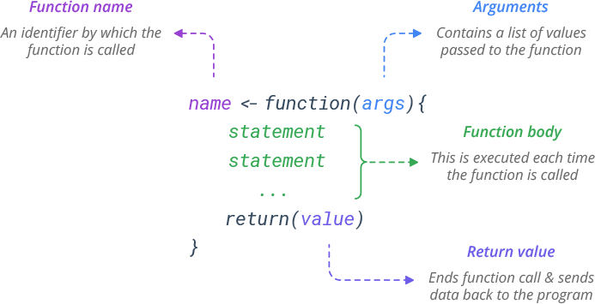
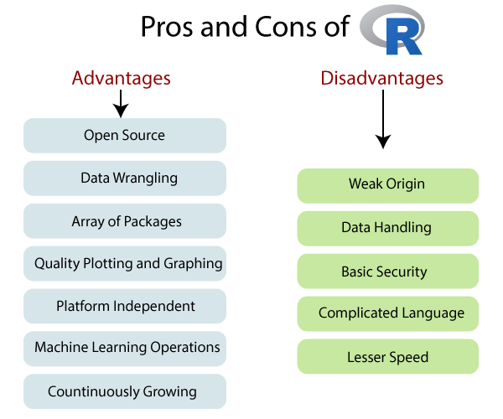
R
Cost | The official R software is open source and free, but RStudio Workbench Standard is $995 yearly for the first 20 users.
Speed | Longer code is required for even simple processes with R. Python is 5.8 times faster than R in some instances.
Analysis & ETL function | R is a procedural language, so the program code is written as a procedure of step-by-step instructions in a sequence where the user has to specify “what to do” and “how to do”. R has a built-in function to directly call in the program by users such as sq(), mean(), max() and user-defined function allowing you to write your own function. R has a lot of support for all sorts of sophisticated and obscure statistical libraries with packages that extend R’s base functionality, including tidyverse to transform, visualize and streamline your workflow; ggplot2, enhancing R’s visualization capabilities; and TensorFlow, extending R’s utility into machine learning. Rstudio for R is used for development. R can be run in Jupyter Notebooks (JN) with the right know-how. Although there are paid ETL tools for R, such as Panoply, Blendo and Stitch. There are also plenty of open-source R ETLs such as Apache Spark, Pentaho Kettle etc.
Alternatives | PythonPython is a general-purpose programming language; whilst RustRust is a systems programming language ; then MATLAB can analyse data and develop algorithms and create models; then you have GolangGo, SAS, RubyRuby, JuliaJulia and JavaJava.
Everyday use cases | R is a programming language made by statisticians for statistics mainly with data: were its widely used by; business analysts, data analysts, data scientists, and scientists; as a language. for statistical computing and data visualizations.

